Slide 1
UNIT-IV

Slide 2
UNIT IV
Uncertain Knowledge and Reasoning :
Bayes’ Rule,
Concepts of Time and Uncertainty,
Utility Functions,
Value of Information,
Value iteration,
Policy iteration,
Partially Observable MDP

Slide 3
Uncertain Knowledge and Reasoning
ACTING UNDER UNCERTAINTY
Agents may need to handle uncertainty, whether due to partial observability, non-determinism, or a combination of the two.
An agent may never know for certain what state it’s in or where it will end up after a sequence of actions.
Problem-solving agents and logical agents designed to handle uncertainty by keeping track of a belief state—a representation of the set of all possible world states that it might be in—and generating a contingency plan that handles every possible eventuality that its sensors may report during execution.

Slide 4
• When interpreting partial sensor information, a logical agent must consider every logically possible explanation for the observations, no matter how unlikely.
This leads to impossible large and complex belief-state representations.
• A correct contingent plan that handles every eventuality can grow arbitrarily large and must consider arbitrarily unlikely contingencies.
• Sometimes there is no plan that is guaranteed to achieve the goal—yet the agent must act.
It must have some way to compare the merits of plans that are not guaranteed.
The right thing to do—the rational decision—therefore depends on both the relative importance of various goals and the likelihood that, and degree to which, they will be achieved.

Slide 5
The right thing to do—the rational decision—therefore depends on both the relative importance of various goals and the likelihood that, and degree to which, they will be achieved.
Trying to use logic to cope with a domain like medical diagnosis thus fails for three main reasons:
• Laziness: It is too much work to list the complete set of antecedents or consequents needed to ensure an exception-less rule and too hard to use such rules.
• Theoretical ignorance: Medical science has no complete theory for the domain.
• Practical ignorance: Even if we know all the rules, we might be uncertain about a particular patient because not all the necessary tests have been or can be run.
The connection between toothaches and cavities is just not a logical consequence in either direction. This is typical of the medical domain, as well as most other judgmental domains: law, business, design, automobile repair, gardening, dating, and so on.

Slide 6
The agent’s knowledge can at best provide only a degree of belief in the relevant sentence.
Probability provides a way of summarizing the uncertainty that comes from our laziness and ignorance, thereby solving the qualification problem.
Uncertainty and rational decisions
An agent must first have preferences between the different possible outcomes of the various plans.
An outcome is a completely specified state, including such factors as whether the agent arrives on time and the length of the wait at the airport.
We use utility theory to represent and reason with preferences.
(The term utility is used here in the sense of “the quality of being useful,” not in the sense of the electric company or water works.)
Utility theory says that every state has a degree of usefulness, or utility, to an agent and that the agent will prefer states with higher utility.

Slide 7
The utility of a state is relative to an agent.
Ex: The utility of a state in which White has checkmated Black in a game of chess is obviously high for the agent playing White, but low for the agent playing Black.
There is no accounting for taste or preferences: you might think that an agent who prefers jalapeno bubble-gum ice cream to chocolate chip is odd or even misguided, but you could not say the agent is irrational.
Preferences, as expressed by utilities, are combined with probabilities in the general theory of rational decisions called decision theory:
Decision theory = probability theory + utility theory
The fundamental idea of decision theory is that an agent is rational if and only if it chooses the action that yields the highest expected utility, averaged over all the possible outcomes of the action.
This is called the principle of maximum expected utility (MEU).

Slide 8
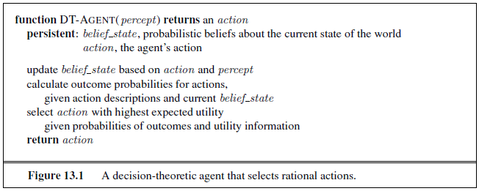
Figure 13.1 sketches the structure of an agent that uses decision theory to select actions.
The agent is identical, at an abstract level, to the other agents described that maintain a belief state reflecting the history of percepts to date.
The primary difference is that the decision-theoretic agent’s belief state represents not just the possibilities for world states but also their probabilities.
Given the belief state, the agent can make probabilistic predictions of action outcomes and hence select the action with highest expected utility.

Slide 9


BAYES’ RULE AND ITS USE
Defined the product rule. It can actually be written in two forms:
P(a ∧ b) = P(a | b)P(b) and P(a ∧ b) = P(b | a)P(a) .
Equating the two right-hand sides and dividing by P(a), we get
This equation is known as Bayes’ rule (Bayes’ law or Bayes’ theorem).
The more general case of Bayes’ rule for multivalued variables can be written in the P notation as follows

Slide 10


use a more general version conditionalized on some background evidence e:
Applying Bayes’ rule: The simple case
Bayes’ rule is useful in practice because there are many cases where we do have good probability estimates for these three numbers and need to compute the fourth.
Bayes’ rule becomes
The conditional probability P(effect CAUSAL | cause) quantifies the relationship in the causal direction, whereas P(cause | effect) describes the diagnostic direction.

Slide 11
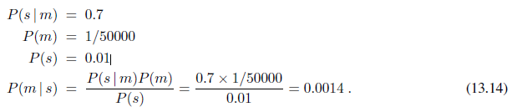
Ex: a doctor knows that the disease meningitis causes the patient to have a stiff neck, say, 70% of the time.
The doctor also knows some unconditional facts: the prior probability that a patient has meningitis is 1/50,000, and the prior probability that any patient has a stiff neck is 1%.
Letting s be the proposition that the patient has a stiff neck and m be the proposition that the patient has meningitis, we have
Expect less than 1 in 700 patients with a stiff neck to have meningitis.
Notice that even though a stiff neck is quite strongly indicated by meningitis (with probability 0.7), the probability of meningitis in the patient remains small.
This is because the prior probability of stiff necks is much higher than that of meningitis.

Slide 12
Using Bayes’ rule: Combining evidence
Bayes’ rule can be useful for answering probabilistic queries conditioned on one piece of evidence—for example, the stiff neck.
Probabilistic information is often available in the form P(effect | cause).
What happens when we have two or more pieces of evidence? For example, what can a dentist conclude if her nasty steel probe catches in the aching tooth of a patient? If we know the full joint distribution (Figure 13.3).
P(Cavity | toothache ∧ catch) = α 0.108, 0.016 ≈ 0.871, 0.129
Bayes’ rule to reformulate the problem:
P(Cavity | toothache ∧ catch) = α P(toothache ∧ catch | Cavity) P(Cavity) … 13.16
For this reformulation to work, we need to know the conditional probabilities of the conjunction toothache ∧catch for each value of Cavity.

Slide 13
TIME AND UNCERTAINTY
Consider a slightly different problem: treating a diabetic patient.
we have evidence such as recent insulin doses, food intake, blood sugar measurements, and other physical signs.
The task is to assess the current state of the patient, including the actual blood sugar level and insulin level.
Given this information, make a decision about the patient’s food intake and insulin dose.
Blood sugar levels and measurements thereof can change rapidly over time, depending on recent food intake and insulin doses, metabolic activity, the time of day, and so on.
To assess the current state from the history of evidence and to predict the outcomes of treatment actions, we must model these changes.

Slide 14
States and observations
We will use X_{t} to denote the set of state variables at time t, which are assumed to be unobservable, and E_{t} to denote the set of observable evidence variables.
The observation at time t is E_{t} =e_{t} for some set of values e_{t}.
The interval between time slices also depends on the problem.
For diabetes monitoring, a suitable interval might be an hour rather than a day.
Assume the interval between slices is fixed, so we can label times by integers.
Assume that the state sequence starts at t=0; for various uninteresting reasons, Assume that evidence starts arriving at t=1 rather than t=0.
Hence, our umbrella world is represented by state variables
R0, R1, R2, . . . and evidence variables U1, U2, . . ..

Slide 15
Use the notation a:b to denote the sequence of integers from a to b (inclusive), and the notation X_{a:b} to denote the set of variables from X_{a} to X_{b}.
Ex: U_{1:3} corresponds to the variables U₁, U₂, U₃.
Transition and sensor models
With the set of state and evidence variables for a given problem decided on, the next step is to specify how the world evolves (the transition model) and how the evidence variables get their values (the sensor model).
The transition model specifies the probability distribution over the latest state variables, given the previous values, that is, P(X_{t} |X₀:t−1).
Face a problem: the set X₀:t−1 is unbounded in size as t increases.
Solve the problem by making a Markov assumption—that the current state depends on only a finite fixed number of previous states.
Processes satisfying this assumption were called Markov processes or Markov chains.
State provides enough information to make the future conditionally independent of the past, and we have
P(X_{t} |X₀:t−1) = P(X_{t} |X_{t}−1) …. (15.1)

Slide 16
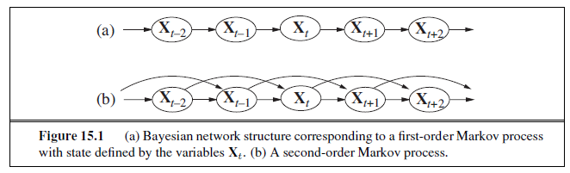
Hence, in a first-order Markov process, the transition model is the conditional distribution P(X_{t} |X_{t}−1). The transition model for a second-order Markov process is the conditional distribution P(X_{t} |X_{t}−2,X_{t}−1).
Figure 15.1 shows the Bayesian network structures corresponding to first-order and second-order Markov processes

Slide 17
Even with the Markov assumption there is still a problem: there are infinitely many possible values of t.
Avoid this problem by assuming that changes in the world state are caused by a stationary process—that is, a process of change that is governed by laws that do not themselves change over time.
(Don’t confuse stationary with static: in a static process, the state itself does not change.)
In the umbrella world, then, the conditional probability of rain, P(R_{t} |R_{t−1}), is the same for all t, and we only have to specify one conditional probability table.
Now for the sensor model. The evidence variables E_{t} could depend on previous variables as well as the current state variables, but any state that’s worth its salt should suffice to generate the current sensor values.
Make a sensor Markov assumption as follows: P(E_{t} |X_{0:t},E_{0:t−1}) = P(E_{t} |X_{t}) . (15.2)
P(E_{t} |X_{t}) is our sensor model (sometimes called the observation model).
Figure 15.2 shows both the transition model and the sensor model for the umbrella example.

Slide 18

Notice theNotice the direction of the dependence between state and sensors: the arrows go from the actual state of the world to sensor values because the state of the world causes the sensors to take on particular values: the rain causes the umbrella to appear.
(The inference process, of course, goes in the other direction; the distinction between the direction of modeled dependencies and the direction of inference is one of the principal advantages of Bayesian networks.)
In addition to specifying the transition and sensor models, we need to say how everything gets started—the prior probability distribution at time 0, P(X0).
With that, we have a specification of the complete joint distribution over all the variables, using Equation (14.2).
The three terms on the right-hand side are the initial state model P(X0), the transition model P(Xi |Xi−1), and the sensor model P(Ei |Xi).
The structure in Figure 15.2 is a first-order Markov process—the probability of rain is
assumed to depend only on whether it rained the previous day.

Slide 19
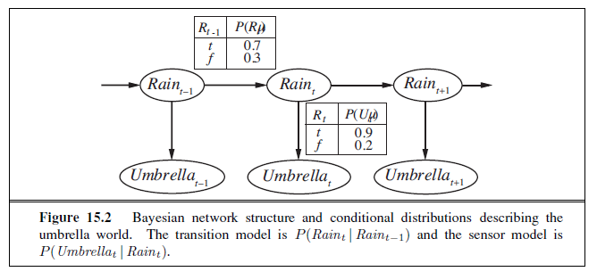

Slide 20
The first-order Markov assumption says that the state variables contain all the information needed to characterize the probability distribution for the next time slice.
Ex: If a particle is executing a random walk along the x-axis, changing its position by ± 1 at each time step, then using the x-coordinate as the state gives a first-order Markov process.
Sometimes predicting rain only on the basis of whether it rained the previous day.
There are two ways to improve the accuracy of the approximation:
Increasing the order of the Markov process model.
Ex: Make a second-order model by adding Rain_{t−2} as a parent of Rain_{t}, which might give slightly more accurate predictions.
Ex: In Palo Alto, California, it very rarely rains more than two days in a row.
2. Increasing the set of state variables.
Ex: Add Season_{t} to allow us to incorporate historical records of rainy seasons, or we could add Temperature_{t}, Humidity_{t} and Pressure_{t} (perhaps at a range of locations) to allow us to use a physical model of rainy conditions.

Slide 21

UTILITY FUNCTIONS
The basic principle of decision theory: the maximization of expected utility.
The behavior of any rational agent can be captured by supposing a utility function that is being maximized.
THE BASIS OF UTILITY THEORY
The principle of Maximum Expected Utility (MEU) seems like a reasonable way to make decisions, but it is by no means obvious that it is the only rational way.
Constraints on rational preferences
the following notation to describe an agent’s preferences:
A and B could be states of the world, but more often than not there is uncertainty about what is really being offered.

Slide 22
Ex: An airline passenger who is offered “the pasta dish or the chicken” does not know what lurks beneath the tinfoil cover.
The pasta could be delicious or congealed, the chicken juicy or overcooked beyond recognition.
Think of the set of outcomes for each action as a lottery—think of each action as LOTTERY a ticket.
A lottery L with possible outcomes S₁, . . . , S_{n} that occur with probabilities p₁, . . . , p_{n} is written L = [p₁, S₁; p₂, S₂; . . . p_{n}, S_{n}] .
Each outcome S_{i} of a lottery can be either an atomic state or another lottery.
The primary issue for utility theory is to understand how preferences between complex lotteries are related to preferences between the underlying states in those lotteries.
To address this issue list six constraints that require any reasonable preference relation to obey:

Slide 23



Orderability: Given any two lotteries, a rational agent must either prefer one to the other or else rate the two as equally preferable.
That is, the agent cannot avoid deciding, refusing to bet is like refusing to allow time to pass.
Transitivity: Given any three lotteries, if an agent prefers A to B and prefers B to C,
then the agent must prefer A to C.
Continuity: If some lottery B is between A and C in preference, then there is some probability p for which the rational agent will be indifferent between getting B for sure and the lottery that yields A with probability p and C with probability 1 − p.
Substitutability: If an agent is indifferent between two lotteries A and B, then the agent is indifferent between two more complex lotteries that are the same except that B is substituted for A in one of them. This holds regardless of the probabilities and the other outcome(s) in the lotteries.

Slide 24
This also holds if we substitute for ∼ in this axiom.
Monotonicity: Suppose two lotteries have the same two possible outcomes, A and B.
If an agent prefers A to B, then the agent must prefer the lottery that has a higher probability for A (and vice versa).
Decomposability: Compound lotteries can be reduced to simpler ones using the laws of probability.
This has been called the “no fun in gambling” rule because it says that two consecutive lotteries can be compressed into a single equivalent lottery, as shown in Figure 16.1(b).
These constraints are known as the axioms of utility theory.
Each axiom can be motivated by showing that an agent that violates it will exhibit patently irrational behavior in some situations.

Slide 25
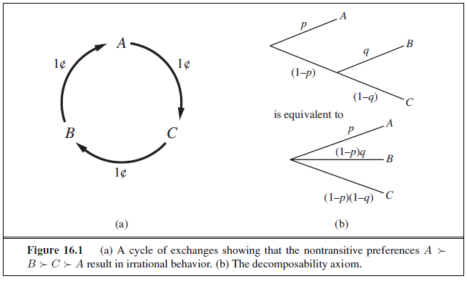
Ex: Motivate transitivity by making an agent with non-transitive preferences give us all its money.
Suppose that the agent has the non-transitive preferences
where A, B, and C are goods that can be freely exchanged.
If the agent currently has A, then we could offer to trade C for A plus one cent.
The agent prefers C, and so would be willing to make this trade.
Then offer to trade B for C, extracting another cent, and finally trade A for B.
This brings us back where we started from, except that the agent has given us three cents (Figure 16.1(a)).
Keep going around the cycle until the agent has no money at all.

Slide 26
UTILITY FUNCTIONS
Utility is a function that maps from lotteries to real numbers.
Know there are some axioms on utilities that all rational agents must obey.
An agent can have any preferences it likes.
Ex: An agent might prefer to have a prime number of dollars in its bank account; in which case, if it had $16 it would give away $3.
This might be unusual, but we can’t call it irrational.
An agent might prefer a dented 1973 Ford Pinto to a shiny new Mercedes.
Preferences can also interact:
Ex: The agent might prefer prime numbers of dollars only when it owns the Pinto, but when it owns the Mercedes, it might prefer more dollars to fewer.
Fortunately, the preferences of real agents are usually more systematic, and thus easier to deal with.

Slide 27
Utility assessment and utility scales
If we want to build a decision-theoretic system that helps the agent make decisions or acts on his or her behalf, we must first work out what the agent’s utility function is.
This process, often called Preference Elicitation, involves presenting choices to the agent and using the observed preferences to pin down the underlying utility function.
Equation (16.2) says that there is no absolute scale for utilities, but it is helpful, nonetheless, to establish some scale on which utilities can be recorded and compared for any particular problem.
It is easy to see, in fact, that an agent’s behavior would not change if its utility function U(S) were transformed according to U’(S) = a U(S) + b …………. (16.2)
where a and b are constants and a > 0; an affine transformation.
A scale can be established by fixing the utilities of any two particular outcomes, just as we fix a temperature scale by fixing the freezing point and boiling point of water.
fix the utility of a “best possible prize” at U(S) = u_{T} and a “worst possible catastrophe” at U(S) = u⊥.
Normalized utilities use a scale with u⊥ = 0 and u_{T} = 1.

Slide 28
Given a utility scale between u_{T} and u⊥, we can assess the utility of any particular prize S by asking the agent to choose between S and a standard lottery [p, u_{T} ; (1−p), u⊥].
The probability p is adjusted until the agent is indifferent between S and the standard lot
Assuming normalized utilities, the utility of S is given by p. Once this is done for each prize, the utilities for all lotteries involving those prizes are determined.
The utility of money
Utility theory has its roots in economics, and it provides one obvious candidate for a utility measure: money (or more specifically, an agent’s total net assets).
The almost universal exchangeability of money for all kinds of goods and services suggests that money plays a significant role in human utility functions.
It will usually be the case that an agent prefers more money to less, all other things being equal.
The agent exhibits a monotonic preference for more money.
This does not mean that money behaves as a utility function, because it says nothing about preferences between lotteries involving money.

Slide 29

If the coin comes up heads, you end up with nothing, but if it comes up tails, you get $2,500,000.
If you’re like most people, you would decline the gamble and pocket the million. Are you being irrational?
Assuming the coin is fair, the Expected Monetary Value (EMV) of the gamble is ½($0) + ½($2,500,000) = $1,250,000, which is more than the original $1,000,000.
But that does not necessarily mean that accepting the gamble is a better decision.
Suppose we use S_{n} to denote the state of possessing total wealth $_{n}, and that your current wealth is $_{k}.
Then the expected utilities of the two actions of accepting and declining the gamble are
To determine what to do, we need to assign utilities to the outcome states.
Utility is not directly proportional to monetary value, because the utility for your first million is very high (or so they say), whereas the utility for an additional million is smaller.

Slide 30
Suppose you assign a utility of 5 to your current financial status (S_{k}), a 9 to the state S_{k+2,500,000}, and an 8 to the state Sk+1,000,000.
Then the rational action would be to decline, because the expected utility of accepting is only 7 (less than the 8 for declining).
On the other hand, a billionaire would most likely have a utility function that is locally linear over the range of a few million more, and thus would accept the gamble.
Utility of money was almost exactly proportional to the logarithm of the amount.
One particular utility curve, for a certain Mr. Beard, is shown in Figure 16.2(a).
The data obtained for Mr. Beard’s preferences are consistent with a utility function
U(S_{k+n}) = −263.31 + 22.09 log(n + 150, 000)
for the range between n = −$150, 000 and n = $800, 000.
We should not assume that this is the definitive utility function for monetary value, but it is likely that most people have a utility function that is concave for positive wealth.
Going into debt is bad, but preferences between different levels of debt can display a reversal of the concavity associated with positive wealth.

Slide 31
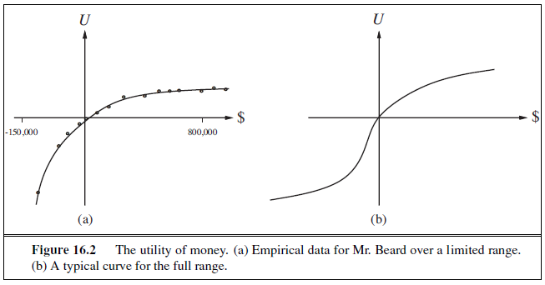
Ex: Someone already $10,000,000 in debt might well accept a gamble on a fair coin with a gain of $10,000,000 for heads and a loss of $20,000,000 for tails.
This yields the S-shaped curve shown in Figure 16.2(b).
If we restrict our attention to the positive part of the curves, where the slope is decreasing, then for any lottery L, the utility of being faced with that lottery is less than the utility of being handed the expected monetary value of the lottery as a sure thing:
U(L) < U(SEMV(L))
Agents with curves of this shape are risk-averse: they prefer a sure thing with a payoff that is less than the expected monetary value of a gamble.
On the other hand, in the “desperate” region at large negative wealth in Figure 16.2(b), the behavior is risk-seeking.

Slide 32

The value an agent will accept in lieu of a lottery is called the certainty equivalent of the lottery.
Studies have shown that most people will accept about $400 in lieu of a gamble that gives $1000 half the time and $0 the other half—that is, the certainty equivalent of the lottery is $400, while the EMV is $500.
The difference between the EMV of a lottery and its certainty equivalent is called the insurance premium.
Risk aversion is the basis for the insurance industry, because it means that insurance premiums are positive.
People would rather pay a small insurance premium than gamble the price of their house against the chance of a fire.
From the insurance company’s point of view, the price of the house is very small compared with the firm’s total reserves.
Expected utility and post-decision disappointment
The rational way to choose the best action, a∗, is to maximize expected utility:
If we have calculated the expected utility correctly according to our probability model, and if the probability model correctly reflects the underlying stochastic processes that generate the outcomes, then, on average, we will get the utility we expect if the whole process is repeated many times.

Slide 33
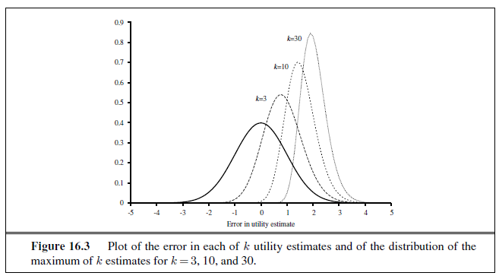
Unfortunately, the real outcome will usually be significantly worse than we estimated, even though the estimate was unbiased! To see why, consider a decision problem in which there are k choices, each of which has true estimated utility of 0.
Suppose that the error in each utility estimate has zero mean and standard deviation of 1, shown as the bold curve in Figure 16.3.
Now, as we actually start to generate the estimates, some of the errors will be negative (pessimistic) and some will be positive (optimistic).
Because we select the action with the highest utility estimate, we are obviously favoring the overly optimistic estimates, and that is the source of the bias.
The curve in Figure 16.3 for k=3 has a mean around 0.85, so the average disappointment will be about 85% of the standard deviation in the utility estimates.

Slide 34

Human judgment and irrationality
Decision theory is a normative theory: it describes how a rational agent should act.
A descriptive theory, on the other hand, describes how actual agents—for example, humans— really do act.
The application of economic theory would be greatly enhanced if the two coincided, but there appears to be some experimental evidence to the contrary.
The evidence suggests that humans are “predictably irrational” (Ariely, 2009).
The best-known problem is the Allais paradox (Allais, 1953). People are given a choice between lotteries A and B and then between C and D, which have the following prizes:
A : 80% chance of $4000 C : 20% chance of $4000
B : 100% chance of $3000 D : 25% chance of $3000
Most people consistently prefer B over A (taking the sure thing), and C over D (taking the higher EMV).
The normative analysis disagrees! We can see this most easily if we use the freedom implied by Equation (16.2) to set U($0) = 0.
In that case, then implies that U($3000) > 0.8 U($4000), whereas
implies exactly the reverse.

Slide 35
Preference structure and multi-attribute utility
Suppose we have n attributes, each of which has d distinct possible values.
To specify the complete utility function U(x1, . . . , xn), we need dn values in the worst case.
Now, the worst case corresponds to a situation in which the agent’s preferences have no regularity at all.
Multi-attribute utility theory is based on the supposition that the preferences of typical agents have much more structure than that.
The basic approach is to identify regularities in the preference behavior we would expect to see and to use what are called representation theorems to show that an agent with a certain kind of preference structure has a utility function
U(x1, . . . , xn) = F[f1(x1), . . . , fn(xn)] ,
where F is, we hope, a simple function such as addition. Notice the similarity to the use of Bayesian networks to decompose the joint probability of several random variables.

Slide 36
DOMINANCE
Suppose that airport site S1 costs less, generates less noise pollution, and is safer than site S2.
One would not hesitate to reject S2. We then say that there is strict dominance of S1 over S2.
In general, if an option is of lower value on all attributes than some other option, it need not be considered further.
Strict dominance is often very useful in narrowing down the field of choices to the real contenders, although it seldom yields a unique choice.
Figure 16.4(a) shows a schematic diagram for the two-attribute case.
That is fine for the deterministic case, in which the attribute values are known for sure.
What about the general case, where the outcomes are uncertain? A direct analog of strict dominance can be constructed, where, despite the uncertainty, all possible concrete outcomes for S1 strictly dominate all possible outcomes for S2. (See Figure 16.4(b).)
Of course, this will probably occur even less often than in the deterministic case.

Slide 37
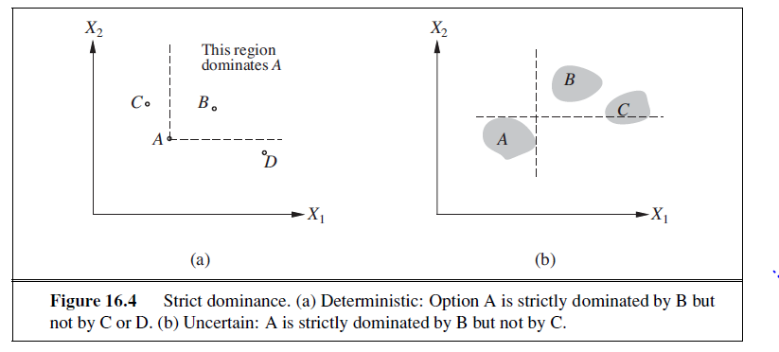
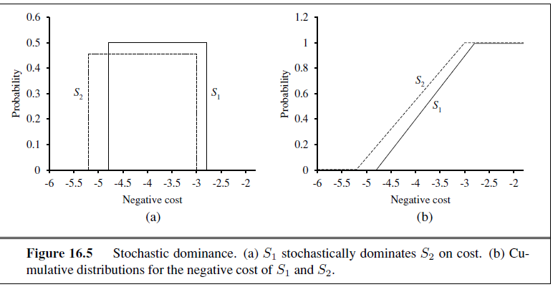

Slide 38
THE VALUE OF INFORMATION
Assumed that all relevant information, or at least all available information, is provided to the agent before it makes its decision.
One of the most important parts of decision making is knowing what questions to ask.
Ex: A doctor cannot expect to be provided with the results of all possible diagnostic tests and questions at the time a patient first enters the consulting room.
Tests are often expensive and sometimes hazardous (both directly and because of associated delays).
Their importance depends on two factors: whether the test results would lead to a significantly better treatment plan, and how likely the various test results are.
Information value theory, which enables an agent to choose what information to acquire.
Assume that, prior to selecting a “real” action represented by the decision node, the agent can acquire the value of any of the potentially observable chance variables in the model.
Information value theory involves a simplified form of sequential decision making—simplified because the observation actions affect only the agent’s belief state, not the external physical state.

Slide 39
The value of any particular observation must derive from the potential to affect the agent’s eventual physical action; and this potential can be estimated directly from the decision model itself.
A simple example
Suppose an oil company is hoping to buy one of n indistinguishable blocks of ocean-drilling rights.
Let us assume further that exactly one of the blocks contains oil worth C dollars, while the others are worthless.
The asking price of each block is C/n dollars.
If the company is risk-neutral, then it will be indifferent between buying a block and not buying one.
A seismologist offers the company the results of a survey of block number 3, which indicates definitively whether the block contains oil.
How much should the company be willing to pay for the information?
The way to answer this question is to examine what the company would do if it had the information:
With probability 1/n, the survey will indicate oil in block 3. In this case, the company will buy block 3 for C/n dollars and make a profit of C −C/n = (n − 1)C/n dollars.

Slide 40

With probability (n−1)/n, the survey will show that the block contains no oil, in which case the company will buy a different block. Now the probability of finding oil in one of the other blocks changes from 1/n to 1/(n −1), so the company makes an expected profit of C/(n − 1) − C/n = C/n(n − 1) dollars.
Calculate the expected profit, given the survey information:
Company should be willing to pay the seismologist up to C/n dollars for the information: the information is worth as much as the block itself.
The value of information derives from the fact that with the information, one’s course of action can be changed to suit the actual situation.
One can discriminate according to the situation, whereas without the information, one has to do what’s best on average over the possible situations.
The value of a given piece of information is defined to be the difference in expected value between best actions before and after information is obtained.

Slide 41
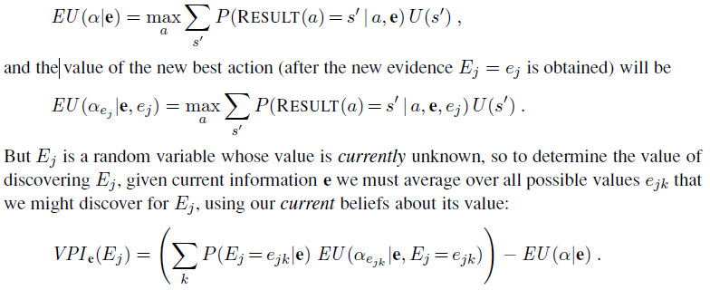
A general formula for perfect information
It is simple to derive a general mathematical formula for the value of information.
We assume that exact evidence can be obtained about the value of some random variable Ej (that is, we learn Ej = ej ), so the phrase value of perfect information (VPI) is used.
Let the agent’s initial evidence be e.
Then the value of the current best action α is defined by

Slide 42
To get some intuition for this formula, consider the simple case where there are only two actions, a1 and a2, from which to choose.
Their current expected utilities are U1 and U2.
The information Ej = ejk will yield some new expected utilities U 1 and U2 for the actions, but before we obtain Ej , we will have some probability distributions over the possible values of U1 and U2 (which we assume are independent).
Suppose that a1 and a2 represent two different routes through a mountain range in winter.
a1 is a nice, straight highway through a low pass, and a2 is a winding dirt road over the top.
a1 is clearly preferable, because it is quite possible that a2 is blocked by avalanches, whereas it is unlikely that anything blocks a1.
U1 is therefore clearly higher than U2.
It is possible to obtain satellite reports Ej on the actual state of each road that would give new expectations, U1 and U2, for the two crossings.
The distributions for these expectations are shown in Figure 16.8(a).

Slide 43
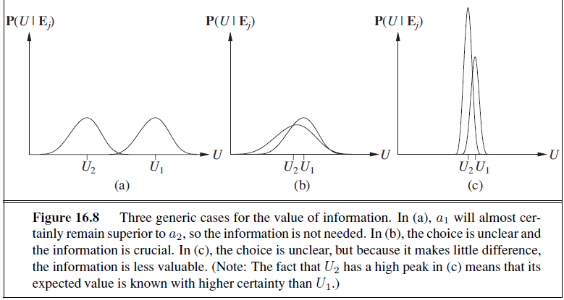
The VPI formula indicates that it might be worthwhile getting the satellite reports. Such a situation is shown in Figure 16.8(b).

Slide 44
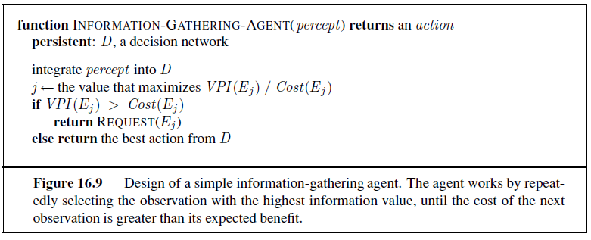
Implementation of an information-gathering agent
The agent algorithm we have described implements a form of information gathering that is called myopic.
This is because it uses the VPI formula shortsightedly, calculating the value of information as if only a single evidence variable will be acquired.
Myopic control is based on the same heuristic idea as greedy search and often works well in practice. (For example, it has been shown to outperform expert physicians in selecting diagnostic tests.)

Slide 45
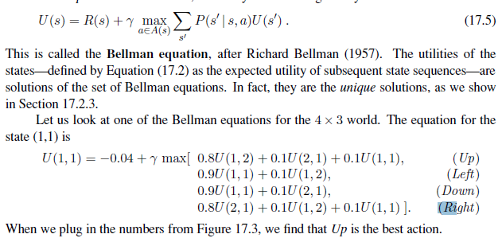
VALUE ITERATION
An algorithm, called value iteration, for calculating an optimal policy is used.
The basic idea is to calculate the utility of each state and then use the state utilities to select an optimal action in each state.
The Bellman equation for utilities
Section 17.1.2 defined the utility of being in a state as the expected sum of discounted rewards from that point onwards.
From this, it follows that there is a direct relationship between the utility of a state and the utility of its neighbors: the utility of a state is the immediate reward for that state plus the expected discounted utility of the next state, assuming that the agent chooses the optimal action.
That is, the utility of a state is given by

Slide 46
THE VALUE ITERATION ALGORITHM
The Bellman equation is the basis of the value iteration algorithm for solving MDPs.
If there are n possible states, then there are n Bellman equations, one for each state.
The n equations contain n unknowns—the utilities of the states.
To solve these simultaneous equations to find the utilities.
There is one problem: the equations are nonlinear, because the “max” operator is not a linear operator.
Whereas systems of linear equations can be solved quickly using linear algebra techniques, systems of nonlinear equations are more problematic.
One thing to try is an iterative approach.
Start with arbitrary initial values for the utilities, calculate the right-hand side of the equation, and plug it into the left-hand side—thereby updating the utility of each state from the utilities of its neighbors.
Repeat this until we reach an equilibrium.
Let Ui(s) be the utility value for state s at the ith iteration.
The iteration step, called a Bellman update, looks like this:

Slide 47
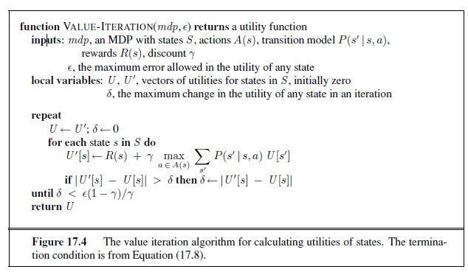

Slide 48
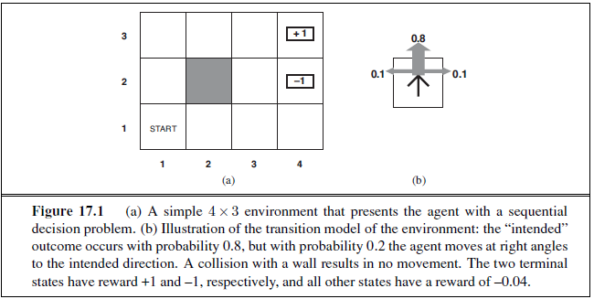
Suppose that an given by ACTIONS(s), sagent is situated in the 4×3 environment shown in Figure 17.1(a).
Beginning in the start state, it must choose an action at each time step.
The interaction with the environment terminates when the agent reaches one of the goal states, marked +1 or –1.
Just as for search problems, the actions available to the agent in each state are given by ACTIONS(s) sometimes abbreviated to A(s); in the 4×3 environment, the actions in every state are Up, Down, Left, and Right. We assume for now that the environment is fully observable, so that the agent always knows where it is.

Slide 49
where the update is assumed to be applied simultaneously to all the states at each iteration.
If we apply the Bellman update infinitely often, we are guaranteed to reach an equilibrium (see Section 17.2.3), in which case the final utility values must be solutions to the Bellman equations.
In fact, they are also the unique solutions, and the corresponding policy (obtained using Equation (17.4)) is optimal.
The algorithm, called VALUE-ITERATION, is shown in Figure 17.4.
We can apply value iteration to the 4×3 world in Figure 17.1(a).
Starting with initial values of zero, the utilities evolve as shown in Figure 17.5(a).
Notice how the states at different distances from (4,3) accumulate negative reward until a path is found to (4,3), whereupon the utilities start to increase.
We can think of the value iteration algorithm as propagating information through the state space by means of local updates.

Slide 50
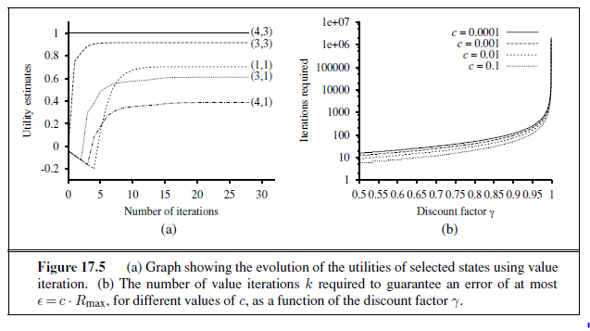

Slide 51
POLICY ITERATION
It is possible to get an optimal policy even when the utility function estimate is inaccurate.
If one action is clearly better than all others, then the exact magnitude of the utilities on the states involved need not be precise.
This insight suggests an alternative way to find optimal policies.
The policy iteration algorithm alternates the following two steps, beginning from some initial policy π0:
• Policy evaluation: given a policy πi, calculate Ui =πi , the utility of each state if πi were to be executed.
• Policy improvement: Calculate a new MEU policy πi+1, using one-step look-ahead based on Ui (as in Equation (17.4)).
The algorithm terminates when the policy improvement step yields no change in the utilities.
Utility function Ui is a fixed point of the Bellman update, so it is a solution to the Bellman equations, and πi must be an optimal policy.
Because there are only finitely many policies for a finite state space, and each iteration can be shown to yield a better policy, policy iteration must terminate.
The algorithm is shown in Figure 17.7.

Slide 52
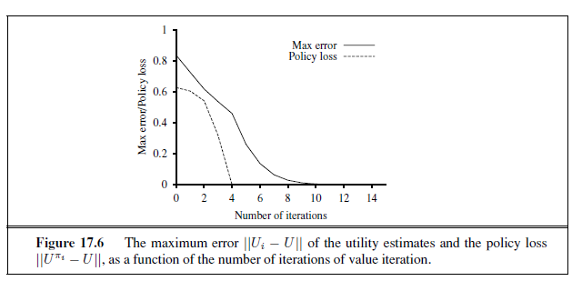
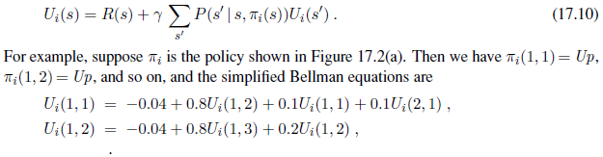
The policy improvement step is obviously straightforward, but how do we implement the POLICY-EVALUATION routine?
It turns out that doing so is much simpler than solving the standard Bellman equations (which is what value iteration does), because the action in each state is fixed by the policy.
At the ith iteration, the policy πi specifies the action πi(s) in state s. This means that we have a simplified version of the Bellman equation (17.5) relating the utility of s (under πi) to the utilities of its neighbors:

Slide 53

The important point is that these equations are linear, because the “max” operator has been removed.
For n states, we have n linear equations with n unknowns, which can be solved exactly in time O(n³) by standard linear algebra methods.
For small state spaces, policy evaluation using exact solution methods is often the most efficient approach.
For large state spaces, O(n³) time might be prohibitive.
Fortunately, it is not necessary to do exact policy evaluation.
Instead, we can perform some number of simplified value iteration steps (simplified because the policy is fixed) to give a reasonably good approximation of the utilities.
The simplified Bellman update for this process is
and this is repeated k times to produce the next utility estimate.
The resulting algorithm is called modified policy iteration. It is often much more efficient than standard policy iteration or value iteration.

Slide 54
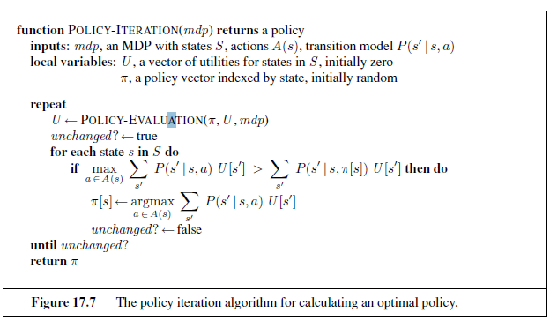
The algorithms we have described so far require updating the utility or policy for all states at once.
It turns out that this is not strictly necessary. In fact, on each iteration, we can pick any subset of states and apply either kind of updating (policy improvement or simplified value iteration) to that subset.
This very general algorithm is called asynchronous policy iteration.

Slide 55
PARTIALLY OBSERVABLE MDPS
The description of Markov decision processes assumed that the environment was fully observable.
With this assumption, the agent always knows which state it is in.
This, combined with the Markov assumption for the transition model, means that the optimal policy depends only on the current state.
When the environment is only partially observable, the situation is, one might say, much less clear.
The agent does not necessarily know which state it is in, so it cannot execute the action π(s) recommended for that state.
Utility of a state s and the optimal action in s depend not just on s, but also on how much the agent knows when it is in s.
For these reasons, partially observable MDPs (or POMDPs— pronounced “pom-dee-pees”) are usually viewed as much more difficult than ordinary MDPs.
Cannot avoid POMDPs, however, because the real world is one.

Slide 56

Definition of POMDPs
To get a handle on POMDPs, we must first define them properly.
A POMDP has the same elements as an MDP—the transition model P(s | s, a), actions A(s), and reward function R(s)—but, like the partially observable search problems, it also has a sensor model P(e | s).
The sensor model specifies the probability of perceiving evidence e in state s.
Ex: Convert the 4×3 world of Figure 17.1 into a POMDP by adding a noisy or partial sensor instead of assuming that the agent knows its location exactly.
Such a sensor might measure the number of adjacent walls, which happens to be 2 in all the non-terminal squares except for those in the third column, where the value is 1; a noisy version might give the wrong value with probability 0.1.
Studied non-deterministic and partially observable planning problems and identified the belief state— the set of actual states the agent might be in—as a key concept for describing and calculating solutions.
In POMDPs, the belief state b becomes a probability distribution over all possible states.
Ex: the initial belief state for the 4×3 POMDP could be the uniform distribution over the nine non-terminal states, i.e.,

Slide 57


Write b(s) for the probability assigned to the actual state s by belief state b.
The agent can calculate its current belief state as the conditional probability distribution over the actual states given the sequence of percepts and actions so far.
This is essentially the filtering task.
The basic recursive filtering equation (15.5 on page 572) shows how to calculate the new belief state from the previous belief state and the new evidence.
For POMDPs, we also have an action to consider, but the result is essentially the same.
If b(s) was the previous belief state, and the agent does action a and then perceives evidence e, then the new belief state is given by
where α is a normalizing constant that makes the belief state sum to 1.
By analogy with the update operator for filtering (page 572), we can write this as
In the 4×3 POMDP, suppose the agent moves Left and its sensor reports 1 adjacent wall; then it’s quite likely (although not guaranteed, because both the motion and the sensor are noisy) that the agent is now in (3,1).
Exercise 17.13 asks you to calculate the exact probability values for the new belief state.

Slide 58
The fundamental insight required to understand POMDPs is this: the optimal action depends only on the agent’s current belief state.
That is, the optimal policy can be described by a mapping π∗(b) from belief states to actions.
It does not depend on the actual state the agent is in.
Decision cycle of a POMDP agent can be broken down into the following three steps:
1. Given the current belief state b, execute the action a=π ∗(b).
2. Receive percept e.
3. Set the current belief state to FORWARD(b, a, e) and repeat.
Think of POMDPs as requiring a search in belief-state space, just like the methods for sensor less and contingency problems.
The main difference is that the POMDP belief-state space is continuous, because a POMDP belief state is a probability distribution.
Ex: a belief state for the 4×3 world is a point in an 11-dimensional continuous space.

Slide 59
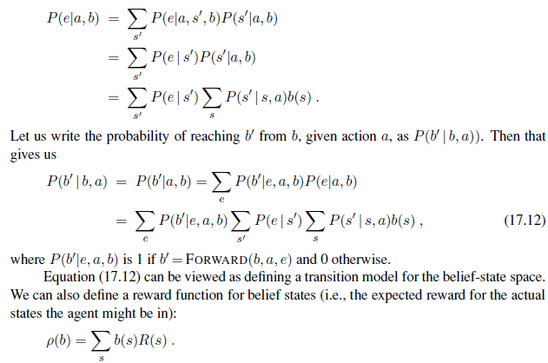
Together, P(b | b, a) and ρ(b) define an observable MDP on the space of belief states.
Shown that an optimal policy for this MDP, π∗(b), is also an optimal policy for the original POMDP.
Solving a POMDP on a physical state space can be reduced to solving an MDP on the corresponding belief-state space.
This fact is perhaps less surprising if we remember that the belief state is always observable to the agent, by definition.

